Slide 1
Research Seminar Series to Support Seminal Researches
by Zsolt T. Kosztyán
Quantitative Research Methodology –
From Data to Evidence
Notes:
SLIDE 1 – TITLE
Research Seminar Series to Support Seminal Researches
by Zsolt T. Kosztyán
Quantitative Research Methodology – From Data to Evidence
Speaker notes:
Welcome to the sixth seminar in our Research Seminar Series. After exploring qualitative methods in RES_05,
we now turn to quantitative research methodology. This session provides a systematic overview of quantitative
methods, organized along four key dimensions.

Slide 2
Agenda
Epistemological and Ontological Foundations
The Four Dimensions of Quantitative Methods
Cross-sectional Methods
Time-series Methods
Comprehensive Method Map & Application Conditions
Key Takeaways and References
Notes:
SLIDE 2 – AGENDA

Slide 3
Epistemological and
Ontological Foundations
Notes:
SLIDE 3 – SECTION

Slide 4
Ontological and Epistemological Position
Positivism / Post-Positivism
Ontology: There is a single, objective, measurable reality
Epistemology: Knowledge is obtained through observation, measurement, and verification
Axiology: Research should be value-free; the researcher is detached
Goal: Explanation, prediction, and generalization through deduction
Key Characteristics:
Deductive approach (theory → hypothesis → data → confirmation/rejection)
Large samples, statistical testing, reproducibility
Objectivity and falsifiability
Source: Creswell (2014); Saunders, Lewis & Thornhill (2019); Bryman (2016)
Notes:
SLIDE 4 – ONTOLOGICAL AND EPISTEMOLOGICAL POSITION
Positivism / Post-Positivism
• Ontology: There is a single, objective, measurable reality
• Epistemology: Knowledge is obtained through observation, measurement, and verification
• Axiology: Research should be value-free; the researcher is detached
• Goal: Explanation, prediction, and generalization through deduction
Key Characteristics:
• Deductive approach (theory → hypothesis → data → confirmation/rejection)
• Large samples, statistical testing, reproducibility
• Objectivity and falsifiability (Popper)
Speaker notes:
Quantitative research is firmly rooted in positivism and post-positivism. The ontological stance assumes an
objective reality that exists independently of our perception. Post-positivism softens this by acknowledging
that our observations are always somewhat imperfect.

Slide 5
Primary vs Secondary Data Sources
Primary Data (e.g., Questionnaires / Surveys)
Philosophical stance: Post-positivist or critical realism – we design instruments to measure latent constructs
Assumption: Respondents' answers reflect an objective underlying reality
Validation: Reliability (Cronbach's α), construct validity, content validity
Example RQ: "Does perceived organizational support affect employee turnover intention?"
Secondary Data (e.g., Statistical Databases, Financial Reports)
Philosophical stance: Positivist – data exists independently; we observe and analyze
Assumption: The data faithfully represents objective phenomena
Validation: Data quality, completeness, source credibility
Example RQ: "How does R&D expenditure affect GDP growth across OECD countries?"
Source: Saunders et al. (2019); Hair et al. (2019)
Notes:
SLIDE 5 – PRIMARY VS SECONDARY DATA SOURCES
Primary Data (Questionnaires): Post-positivist, latent constructs
Secondary Data (Statistical DB): Positivist, objective record
Speaker notes:
With questionnaires we adopt post-positivism (measurement instruments are imperfect approximations).
With secondary data we lean toward pure positivism (data = objective record of reality).

Slide 6
Paradigms in Quantitative Research
Paradigm | Data Source | Approach | Example Question
Positivism | Secondary (statistical DB) | Deductive, confirmatory | "Does higher FDI lead to lower unemployment?"
Post-positivism | Primary (questionnaire) | Deductive, hypothesis testing | "Does training improve job satisfaction?"
Pragmatism | Mixed (primary+secondary) | Problem-driven, flexible | "What combination of factors best predicts firm survival?"
Source: Creswell (2014); Guba & Lincoln (1994); Saunders et al. (2019)
Notes:
SLIDE 6 – PARADIGMS TABLE

Slide 7
The Four Dimensions of
Quantitative Methods
Notes:
SLIDE 7

Slide 8
A Four-Dimensional Framework
Every quantitative method can be positioned along four dimensions:
D1 – Temporal design: Cross-sectional (snapshot) vs. Time-series (longitudinal)
D2 – Analytical purpose: Relationship analysis (regression, ANOVA) vs. Model reduction (PCA, FA) vs. Data reduction (clustering)
D3 – Research logic: Data-driven (exploratory, pattern discovery, no a priori hypotheses) vs. Model-driven (confirmatory, testing an existing model)
D4 – Methodological era: Classical (established statistical methods) vs. Modern (machine learning, latent variable models)
Model-driven research seeks causal relationships; data-driven research discovers patterns.
Source: Hair et al. (2019); James et al. (2021); Hastie, Tibshirani & Friedman (2009)
Notes:
SLIDE 8 – 4D FRAMEWORK
D1: Cross-sectional vs Time-series
D2: Relationship vs Model reduction vs Data reduction
D3: Data-driven vs Model-driven
D4: Classical vs Modern
Key: Model-driven = relationships (cause-effect); Data-driven = patterns (co-occurrence)

Slide 9
D1: Cross-sectional vs. Time-series
Aspect | Cross-sectional | Time-series / Longitudinal
Time horizon | Single point in time (snapshot) | Multiple points in time (trend, panel)
Goal | Describe state, find associations | Detect change, causality, dynamics
Typical data | Survey at one time, census data | Panel data, stock prices, quarterly GDP
Limitation | Cannot establish temporal causality | Requires repeated measurement, costly
Example RQ | "What factors are associated with job satisfaction today?" | "How does employee satisfaction evolve over 5 years?"
Source: Wooldridge (2020); Bryman (2016)
Notes:
SLIDE 9

Slide 10
D2: Analytical Purpose
Purpose | Goal | Key Methods | Example RQ
Relationship analysis | Identify / test associations or causal effects | Regression, ANOVA, Correlation, SEM | "Does leadership style affect innovation performance?"
Model reduction | Reduce many variables to fewer latent dimensions | PCA, Factor Analysis, CFA, ICA, NDA | "What underlying dimensions explain 30 survey items?"
Data reduction | Group observations into meaningful clusters/segments | K-means, Hierarchical clustering, LCA, NDA | "What distinct customer segments exist in our market?"
Source: Hair et al. (2019); Tabachnick & Fidell (2019)
Notes:
SLIDE 10

Slide 11
D3: Data-driven vs. Model-driven
Data-driven (Exploratory)
No prior model or hypothesis – we "let the data speak"
Goal: Discover patterns, associations, latent structures
Risk: Overfitting, spurious patterns ("p-hacking")
Typical: nonparametric regression, NDA, cluster analysis, association rules
Model-driven (Confirmatory)
Start from theory → build a formal model → test against data
Goal: Confirm/reject hypothesized causal relationships
Risk: Model misspecification, confirmation bias
Typical: SEM, CFA, hypothesis-driven regression, ARIMA
Model-driven → seeks relationships (cause-effect);
Data-driven → seeks patterns (co-occurrence)
Source: Hair et al. (2019); Hastie et al. (2009); Breiman (2001)
Notes:
SLIDE 11

Slide 12
D4: Classical vs. Modern Methods
Aspect | Classical | Modern
Era | Pre-2000 mainstream | Post-2000 / ML era
Assumptions | Strong distributional assumptions (normality, linearity, independence) | Fewer assumptions, flexible, nonlinear
Interpretability | High – clear coefficients and p-values | Variable – from moderate (SEM) to low (deep learning)
Examples | OLS regression, ANOVA, PCA, K-means, ARIMA | SEM, PLS-SEM, LCA, association rules, LSTM, random forests
Typical use | Smaller samples, theory testing | Big data, complex models, pattern discovery
Source: James et al. (2021); Hastie, Tibshirani & Friedman (2009)
Notes:
SLIDE 12

Slide 13
Cross-sectional Methods
Notes:
SLIDE 13

Slide 14
Cross-sectional – Relationship Analysis
Method | D3: Logic | D4: Era | Example Research Question
Stepwise Regression | Data-driven | Classical | "Which of 20 potential factors best predict customer satisfaction?"
Association Rule Mining | Data-driven | Modern | "What product combinations are frequently purchased together in retail transactions?"
Multiple Linear Regression / ANOVA | Model-driven | Classical | "Does training duration significantly improve performance, controlling for experience?"
Structural Equation Modeling (SEM) | Model-driven | Modern | "Does organizational culture mediate the effect of leadership style on innovation output?"
Source: Hair et al. (2019); Agrawal & Srikant (1994); Kline (2016)
Notes:
SLIDE 14 – CROSS – RELATIONSHIP ANALYSIS
Stepwise Regression: Data-driven, Classical
Association Rule Mining: Data-driven, Modern
Multiple Regression/ANOVA: Model-driven, Classical
SEM: Model-driven, Modern

Slide 15
Application Conditions: Relationship Analysis (Cross)
Multiple Linear Regression / ANOVA
Continuous (regression) or categorical (ANOVA) independent variables
Assumptions: normality of residuals, homoscedasticity, no multicollinearity (VIF < 5)
Sample: n ≥ 50 + 8×k (Tabachnick & Fidell rule), where k = number of predictors
Structural Equation Modeling (SEM)
Requires a priori theoretical model with measurement + structural components
Sample: n ≥ 200 (Kline, 2016); 5–10 observations per estimated parameter
Fit indices: CFI > 0.95, RMSEA < 0.06, SRMR < 0.08 (Hu & Bentler, 1999)
Association Rule Mining
Requires transactional / binary data; large sample preferred (n > 1,000)
Key metrics: support, confidence, lift; no distributional assumptions
Source: Tabachnick & Fidell (2019); Kline (2016); Hu & Bentler (1999)
Notes:
SLIDE 15

Slide 16
Cross-sectional – Model Reduction
Method | D3: Logic | D4: Era | Example Research Question
Principal Component Analysis (PCA) | Data-driven | Classical | "What are the main dimensions underlying 30 customer satisfaction survey items?"
Independent Component Analysis (ICA) | Data-driven | Modern | "Can we extract independent latent signals from mixed biomedical measurements?"
Confirmatory Factor Analysis (CFA) | Model-driven | Classical | "Does the hypothesized 3-factor structure of organizational commitment fit the data?"
PLS-SEM (Formative constructs) | Model-driven | Modern | "Does the proposed measurement model of digital readiness hold across industries?"
Source: Hair et al. (2019); Hyvärinen & Oja (2000); Kline (2016)
Notes:
SLIDE 16

Slide 17
Application Conditions: Model Reduction (Cross)
Principal Component Analysis (PCA) / Exploratory Factor Analysis (EFA)
KMO > 0.6, Bartlett's test significant (p < 0.05)
Sample: n ≥ 5–10 per variable; minimum n = 100–300
Rotation: varimax (orthogonal) or promax (oblique)
Confirmatory Factor Analysis (CFA)
Requires a priori factor structure based on theory or prior EFA
Same fit indices as SEM (CFI, RMSEA, SRMR)
Convergent validity: AVE > 0.5; Discriminant validity: Fornell-Larcker criterion
ICA / PLS-SEM
ICA: assumes non-Gaussian sources; suitable for signal separation
PLS-SEM: no distributional assumptions; works with small samples (n ≥ 30)
PLS-SEM: suited for formative + reflective constructs, prediction focus
Source: Hair et al. (2019); Hyvärinen & Oja (2000); Fornell & Larcker (1981)
Notes:
SLIDE 17

Slide 18
Cross-sectional – Data Reduction
Method | D3: Logic | D4: Era | Example Research Question
K-means / Hierarchical Clustering | Data-driven | Classical | "What distinct customer segments exist based on purchasing behavior?"
Latent Class Analysis (LCA) | Data-driven | Modern | "What latent subgroups of risk-taking behavior exist among adolescents?"
Discriminant Analysis | Model-driven | Classical | "Can we correctly classify firms into high/low performance based on financial ratios?"
Finite Mixture Models | Model-driven | Modern | "Do the theoretically expected consumer segments emerge from the data?"
Source: Kaufman & Rousseeuw (2005); Collins & Lanza (2010); McLachlan & Peel (2000)
Notes:
SLIDE 18

Slide 19
Application Conditions: Data Reduction (Cross)
K-means / Hierarchical Clustering
Continuous variables preferred; standardize variables (z-scores) before clustering
K-means: specify k a priori → elbow method, silhouette analysis to find optimal k
No distributional assumptions; sensitive to outliers (consider k-medoids)
Latent Class Analysis (LCA)
Categorical/binary indicator variables; model-based → BIC/AIC for model selection
Sample: n ≥ 300–500 depending on number of classes and indicators
Provides class membership probabilities (soft clustering)
Discriminant Analysis / Finite Mixture Models
DA: requires known group membership → multivariate normality, equal covariances
FMM: combines model-driven theory with probabilistic class assignment
Source: Kaufman & Rousseeuw (2005); Collins & Lanza (2010); McLachlan & Peel (2000)
Notes:
SLIDE 19

Slide 20
Time-series Methods
Notes:
SLIDE 20

Slide 21
Time-series – Relationship Analysis
Method | D3: Logic | D4: Era | Example Research Question
Granger Causality Test | Data-driven | Classical | "Does advertising expenditure Granger-cause sales revenue over time?"
LSTM / Deep Learning for Time Series | Data-driven | Modern | "Can we predict stock price movements from historical patterns without a priori model?"
Time Series Regression / ARIMA | Model-driven | Classical | "How does GDP growth rate affect unemployment over time (Okun's Law)?"
Dynamic SEM / Cross-lagged Panel Model | Model-driven | Modern | "Does job satisfaction at t1 predict organizational commitment at t2 and vice versa?"
Source: Granger (1969); Box et al. (2015); Hamaker et al. (2015); Hochreiter & Schmidhuber (1997)
Notes:
SLIDE 21

Slide 22
Application Conditions: Relationship Analysis (Time)
Time Series Regression / ARIMA
Stationarity required → unit root tests (ADF, KPSS); differencing if needed
ARIMA(p,d,q): identify order via ACF/PACF plots or information criteria
Sufficient time points: T ≥ 50 recommended (Box-Jenkins method)
Granger Causality
Stationarity required; lag selection via BIC/AIC
Tests temporal precedence, NOT true causality
Dynamic SEM / Cross-lagged Panel Model
Minimum 3 time points; n ≥ 200 per wave for stable estimates
Accounts for autoregressive and cross-lagged effects simultaneously
LSTM / Deep Learning
Large datasets (thousands of observations); no distributional assumptions
Requires careful hyperparameter tuning; risk of overfitting
Source: Box et al. (2015); Hamaker et al. (2015); Goodfellow et al. (2016)
Notes:
SLIDE 22

Slide 23
Time-series – Model Reduction
Method | D3: Logic | D4: Era | Example Research Question
Dynamic Factor Analysis (exploratory) | Data-driven | Classical | "What common latent trends drive multiple economic indicators over time?"
Temporal ICA / Functional PCA | Data-driven | Modern | "Can we decompose fMRI time series into independent temporal components?"
Confirmatory Dynamic Factor Analysis | Model-driven | Classical | "Does the proposed two-factor model of mood dynamics fit daily diary data?"
Latent Growth Curve Modeling (LGCM) | Model-driven | Modern | "Does a quadratic growth model describe reading skill development in children?"
Source: Molenaar (1985); McArdle & Epstein (1987); Ramsay & Silverman (2005)
Notes:
SLIDE 23

Slide 24
Application Conditions: Model Reduction (Time)
Dynamic Factor Analysis (DFA)
Multiple time series observed simultaneously; T ≥ 50–100 per series
Explores common latent factors driving observed temporal patterns
Latent Growth Curve Modeling (LGCM)
Minimum 3 time points (4+ for nonlinear growth); n ≥ 200
Assumes specific growth trajectory (linear, quadratic, etc.)
Can incorporate time-varying and time-invariant covariates
Temporal ICA / Functional PCA
High-dimensional time series data (e.g., neuroimaging, sensor data)
FPCA: treats observations as functions; smoothing required
ICA: assumes statistical independence of sources
Source: Molenaar (1985); McArdle & Epstein (1987); Ramsay & Silverman (2005)
Notes:
SLIDE 24

Slide 25
Time-series – Data Reduction
Method | D3: Logic | D4: Era | Example Research Question
Time Series Clustering (DTW) | Data-driven | Classical | "What patterns of GDP development exist among EU countries over 20 years?"
Hidden Markov Models (HMM) | Data-driven | Modern | "What latent states underlie customer engagement sequences over time?"
Sequence Analysis (Optimal Match.) | Model-driven | Classical | "Can we classify career trajectories into theoretically expected types?"
Latent Transition Analysis (LTA) | Model-driven | Modern | "Do individuals transition between hypothesized health behavior classes over time?"
Source: Berndt & Clifford (1994); Rabiner (1989); Abbott & Tsay (2000); Collins & Lanza (2010)
Notes:
SLIDE 25

Slide 26
Application Conditions: Data Reduction (Time)
Time Series Clustering (DTW-based)
Dynamic Time Warping handles different-length or phase-shifted series
Requires distance matrix computation → O(n²T²) complexity
Use with hierarchical or partitional clustering on the distance matrix
Hidden Markov Models (HMM)
Sequential/temporal data with discrete or continuous observations
Number of hidden states selected via BIC/cross-validation
Assumes Markov property (memoryless transitions)
Latent Transition Analysis (LTA)
Extension of LCA to multiple time points; categorical indicators
Estimates transition probabilities between latent classes over time
Sample: n ≥ 300–500; minimum 2 time points (3+ preferred)
Source: Berndt & Clifford (1994); Rabiner (1989); Collins & Lanza (2010)
Notes:
SLIDE 26

Slide 27
Comprehensive Method Map
& Application Conditions
Notes:
SLIDE 27

Slide 28
Method Map: Cross-sectional (D1 = Cross)
D2: Purpose | D3: Logic | D4: Classical | D4: Modern
Relationship | Data-driven | Stepwise Regression | Association Rule Mining
Relationship | Model-driven | OLS Regression / ANOVA | SEM
Model reduction | Data-driven | PCA / EFA | ICA
Model reduction | Model-driven | CFA | PLS-SEM
Data reduction | Data-driven | K-means / Hier. Clust. | LCA
Data reduction | Model-driven | Discriminant Analysis | Finite Mixture Models
Notes:
SLIDE 28

Slide 29
Method Map: Time-series (D1 = Time)
D2: Purpose | D3: Logic | D4: Classical | D4: Modern
Relationship | Data-driven | Granger Causality | LSTM / Deep Learning
Relationship | Model-driven | ARIMA / TS Regression | Dynamic SEM / CLPM
Model reduction | Data-driven | Dynamic Factor Analysis | Temporal ICA / FPCA
Model reduction | Model-driven | Confirm. Dynamic FA | LGCM
Data reduction | Data-driven | TS Clustering (DTW) | HMM
Data reduction | Model-driven | Sequence Analysis (OM) | LTA
Notes:
SLIDE 29

Slide 30
Key Takeaways
1. Quantitative methods are rooted in positivism/post-positivism – objective measurement, hypothesis testing, generalizability
2. The four dimensions (temporal design, analytical purpose, research logic, era) provide a systematic framework for method selection
3. Model-driven research tests existing theories (relationships); data-driven research discovers new patterns
4. Classical methods assume more, explain more; modern methods assume less, predict more
5. Always justify your method choice along all four dimensions in your paper
6. Check application conditions BEFORE collecting data – sample size, distributional assumptions, measurement level
Notes:
SLIDE 30

Slide 31

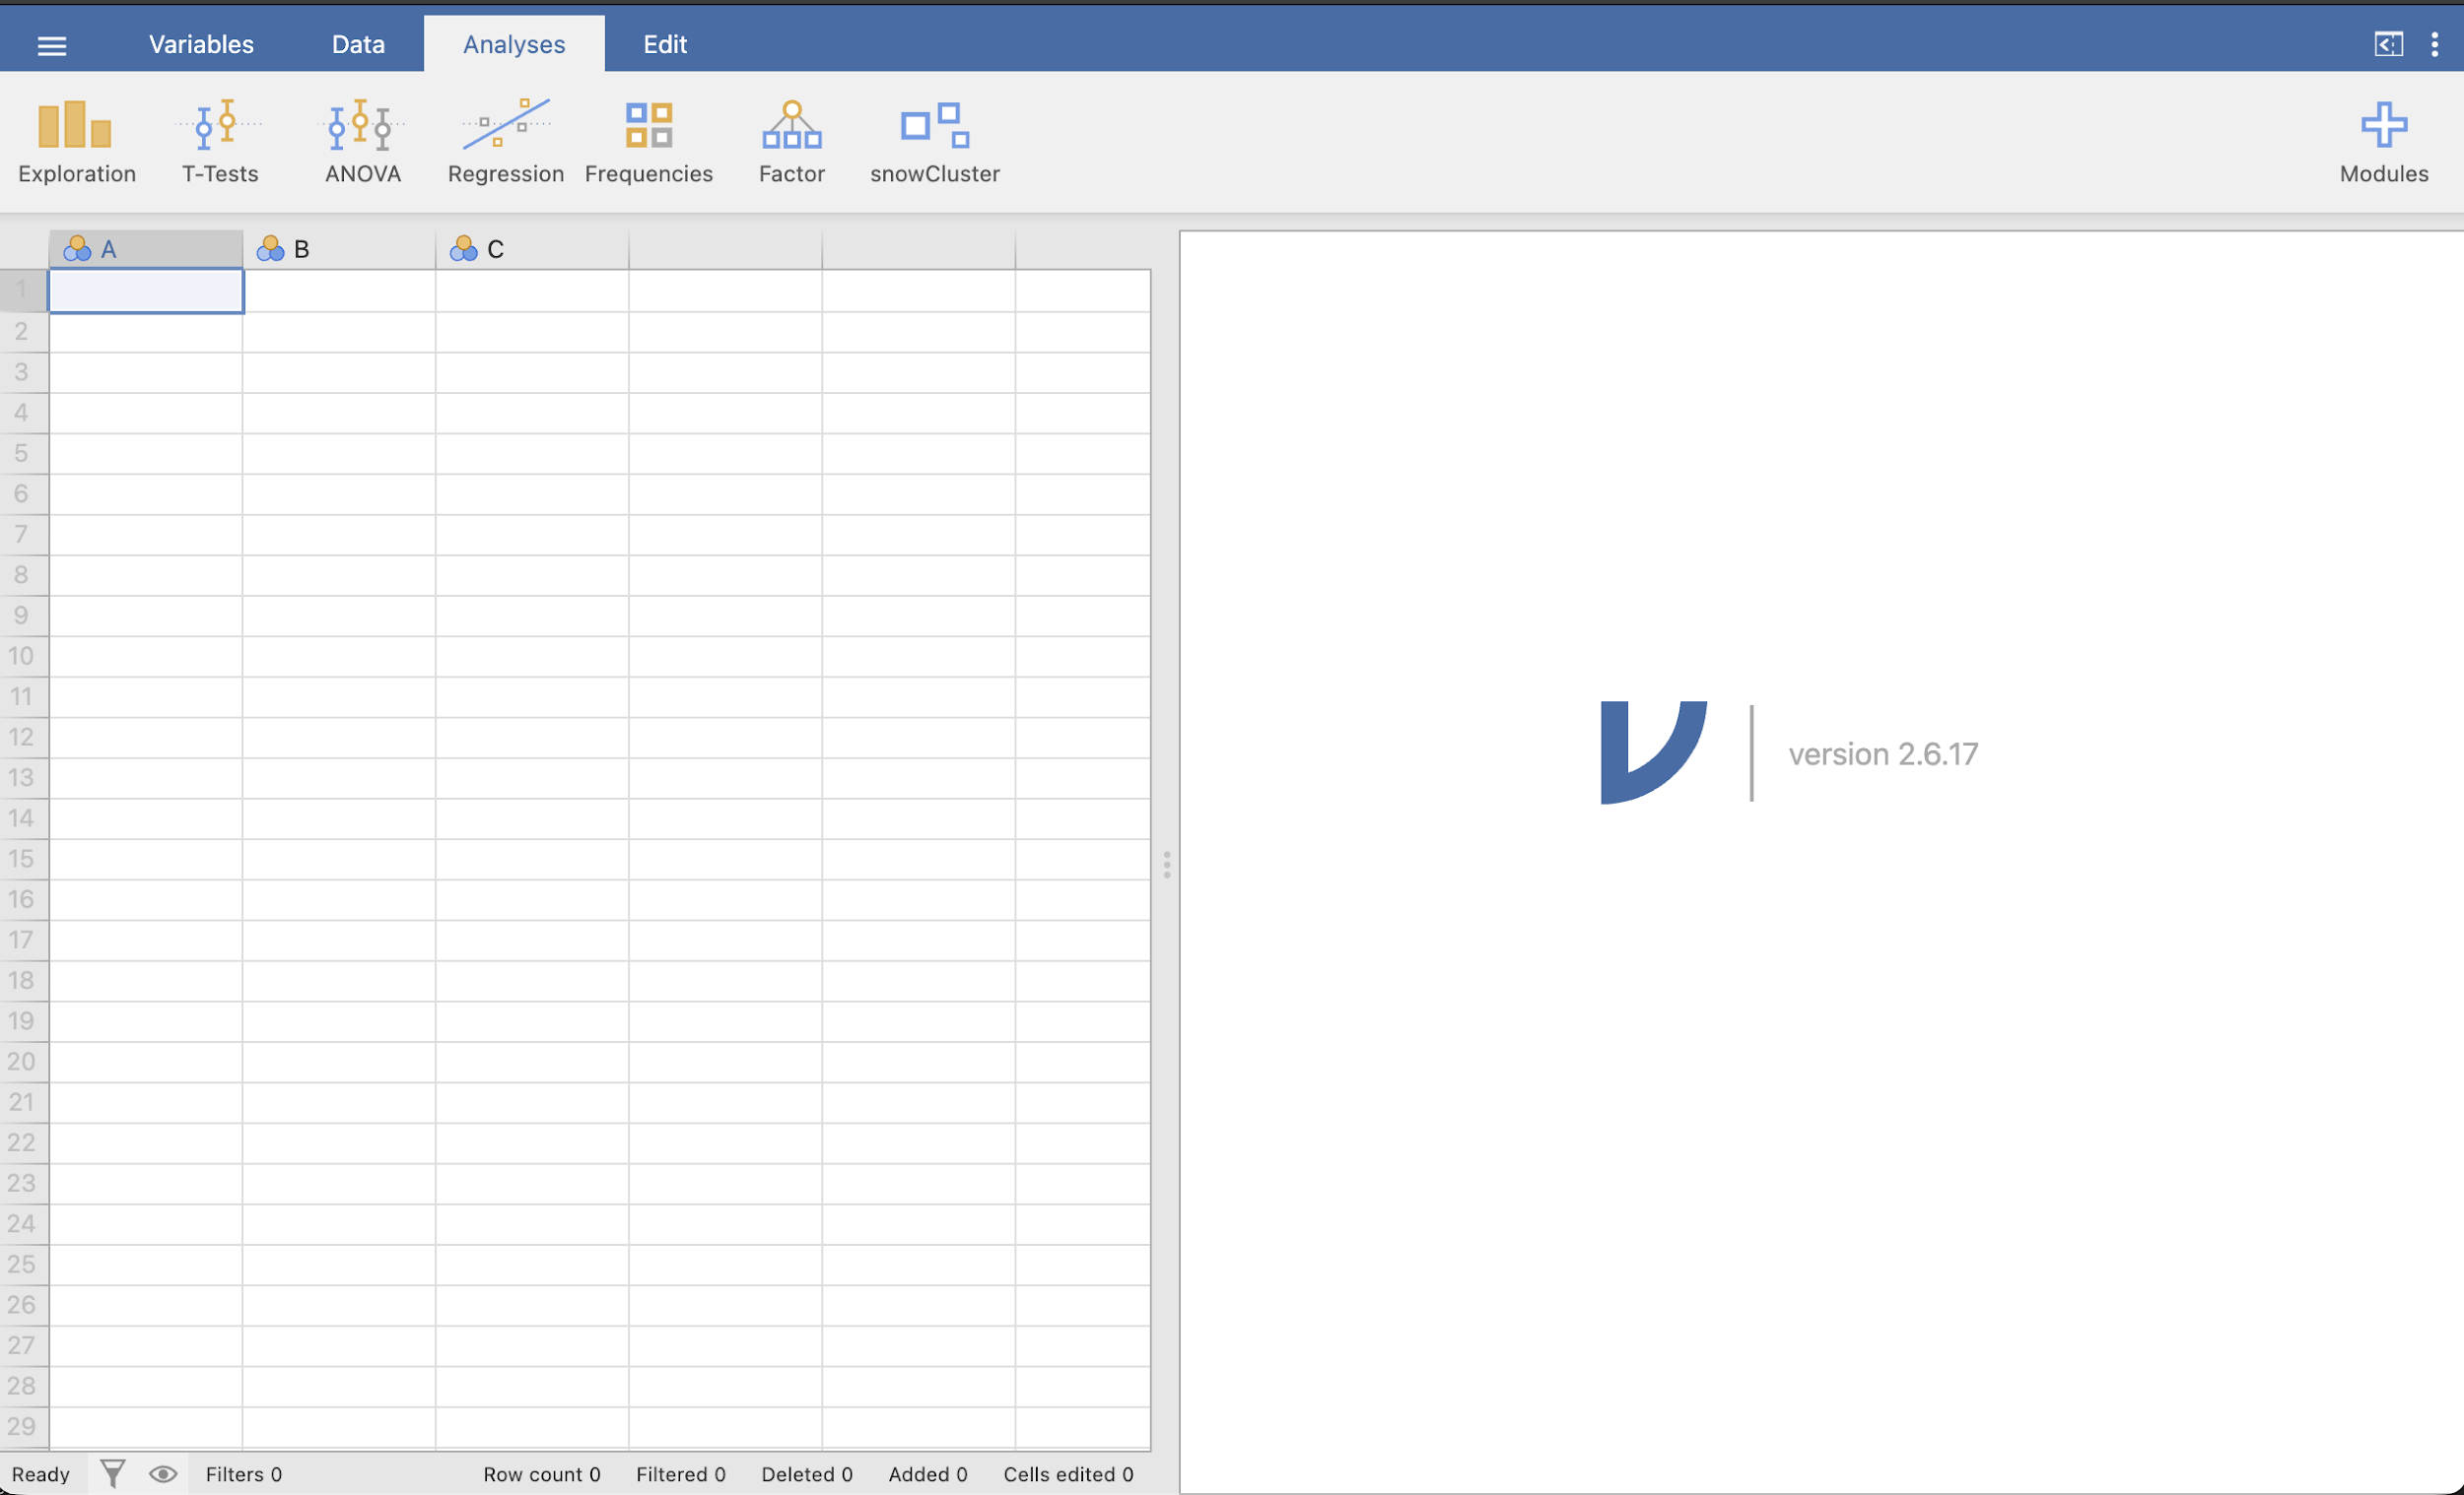
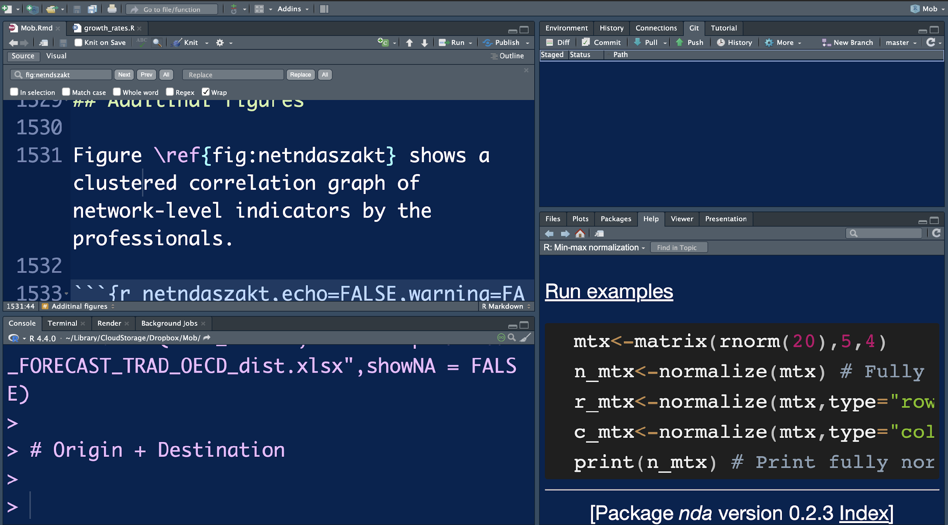
Free Tools and Applications
https://jasp-stats.org
https://www.jamovi.org
https://posit.co/download/rstudio-desktop/

Slide 32
References
Abbott, A. & Tsay, A. (2000). Sequence analysis. Sociological Methods & Research, 29(1), 3–33.
Agrawal, R. & Srikant, R. (1994). Fast algorithms for mining association rules. VLDB, 487–499.
Box, G.E.P. et al. (2015). Time Series Analysis (5th ed.). Wiley.
Breiman, L. (2001). Statistical modeling: The two cultures. Statistical Science, 16(3), 199–231.
Bryman, A. (2016). Social Research Methods (5th ed.). Oxford University Press.
Collins, L.M. & Lanza, S.T. (2010). Latent Class and Latent Transition Analysis. Wiley.
Creswell, J.W. (2014). Research Design (4th ed.). SAGE.
Fornell, C. & Larcker, D.F. (1981). Evaluating SEM. J. of Marketing Research, 18(1), 39–50.
Granger, C.W.J. (1969). Investigating causal relations. Econometrica, 37, 424–438.
Hair, J.F. et al. (2019). Multivariate Data Analysis (8th ed.). Cengage.
Hastie, T., Tibshirani, R. & Friedman, J. (2009). Elements of Statistical Learning. Springer.
Hu, L. & Bentler, P.M. (1999). Cutoff criteria for fit indexes. SEM, 6(1), 1–55.
James, G. et al. (2021). Intro to Statistical Learning (2nd ed.). Springer.
Kaufman, L. & Rousseeuw, P.J. (2005). Finding Groups in Data. Wiley.
Kline, R.B. (2016). Principles and Practice of SEM (4th ed.). Guilford.
McLachlan, G. & Peel, D. (2000). Finite Mixture Models. Wiley.
Saunders, M. et al. (2019). Research Methods for Business Students (8th ed.). Pearson.
Tabachnick, B.G. & Fidell, L.S. (2019). Using Multivariate Statistics (7th ed.). Pearson.
Wooldridge, J.M. (2020). Introductory Econometrics (7th ed.). Cengage.
Notes:
SLIDE 31

Slide 33
Thank you for your attention!
Contacts: zsolt.kosztyan@iask.hu, kosztyan.zsolt@gtk.uni-pannon.hu
Notes:
SLIDE 32

